Slide 1
Rest on aws
Jhulfikar Ali Ahamed Kabeer
Date: 26 Feb 2017

Slide 2
Agenda
Objective - Running rest application in AWS (Language: Java)
Introduction to Rest services
Small Introduction to Microservices
Small Introduction to Docker and Containerization
Deploying the sample Rest Application to AWS
Continuous Learning

Slide 3
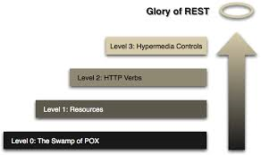
Richardson maturity model
Resource
Http verb
HEAD – Idempotent, Safe
OPTIONS – Idempotent, Safe
GET – Idempotent, Safe
DELETE - Idempotent
PUT - Idempotent
POST
PATCH
Response codes
200x
300x
400x
500x
HATEOAS (Hypermedia as the Engine of Application State)

Slide 4
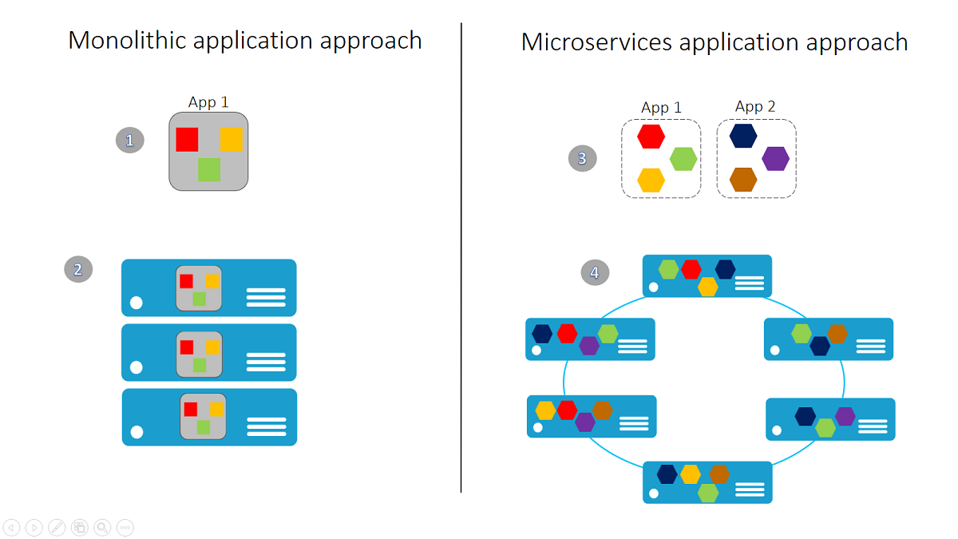
Microservices
They are not
Monolithic / Layered / Intelligently or centrally integrated architectures
Benefits
Autonomy & Responsibilities, Scalability, Innovation & Speed, Technology diversity, Lower developer cognitive load
Complexities
Communication, Execution (Investment), Resilience, Maintenance, Operational
Useful tools
Monitoring
Graphite, Riemann, WatchDog/CloudDog
Logging
Logstash, Kibana or Splunk
Deployment
Green field development (Green/Blue server)
Resilience
Hysterix, ChaosMonkey

Slide 5
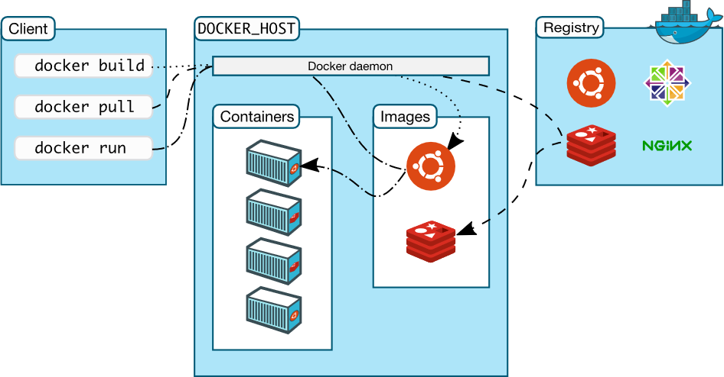
docker

Slide 6
Steps for sample app deployment
Deploy hello world
Search for logs
Running the application
Time for next course (Suggestions needed)

Slide 7
Questions/feedback

